Slide 1
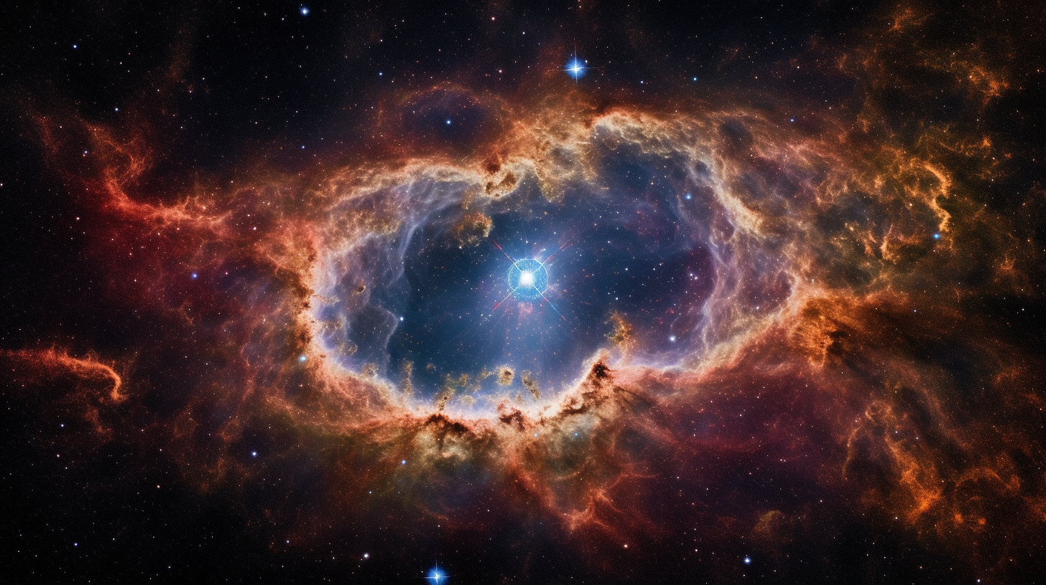
OBSERVATION OF COSMIC GAMMA-RAY BURSTS WITH THE ASIM MISSION ONBOARD THE INTERNATIONAL SPACE STATION
Master Thesis in Space Physics by Andreas Ramsli
Notes:
General notes:
-Show many figures, and don’t put too much text into the slides. If you need to convey information, this should be done oral, not via many bullet points!
-Go through the thesis and find out which key information should be presented in these slides

Slide 2
Goal of this project
Primary goal: Investigate ASIM's GRB detection capabilities
Cross-validation: Compare ASIM with Konus-WIND and Fermi GBM
Systematic exploration: Analyze cosmological GRBs detected by ASIM
Outcome: Determine ASIM's GRB detection precision and accuracy
Notes:
1. The primary goal of this study was to investigate the capabilities of the Atmosphere-Space Interactions Monitor (ASIM) as a gamma-ray burst (GRB) detector and to cross-validate its performance with other spacecraft, such as Konus-WIND and Fermi GBM
2. By conducting the first systematic exploration of cosmological GRBs detected by ASIM, in conjunction with observations from Konus-WIND and the Fermi Gamma-ray Burst Monitor, we were able to determine the precision and accuracy of ASIM's GRB detection capabilities and create a catalog/database of several GRBs

Slide 3
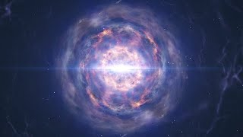
GRB
Notes:
GRBs are the most luminous events in the universe. For comparison, a GRB will emit the total energy released by our sun in it’s 10 billion life, within less than a second. On the other hand, the luminosity of a GRB is comparable to the total star-light luminosity of a billion Milky Way Galaxies.
Neutron star mergers vs. core-collapse supernovae: Neutron star mergers are likely the dominant site for producing heavy elements through the r-process.
Favorable conditions: Neutron star mergers provide an environment with extremely high neutron densities and temperatures, ideal for the rapid capture of neutrons by atomic nuclei.

Slide 4
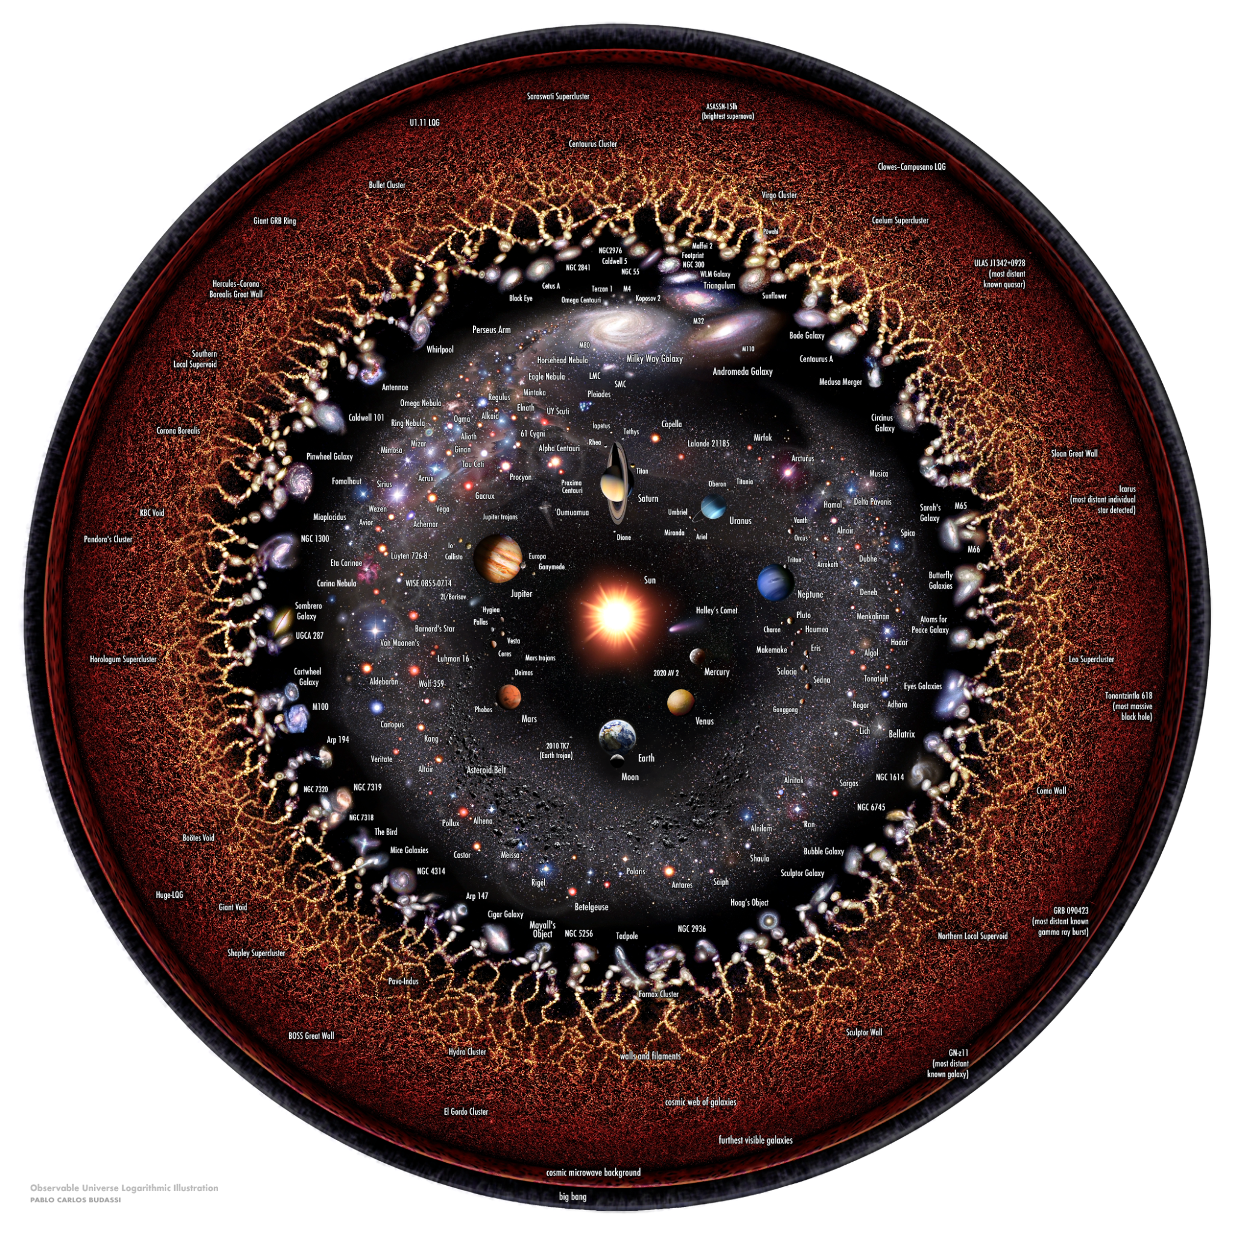
GRBs

Slide 5
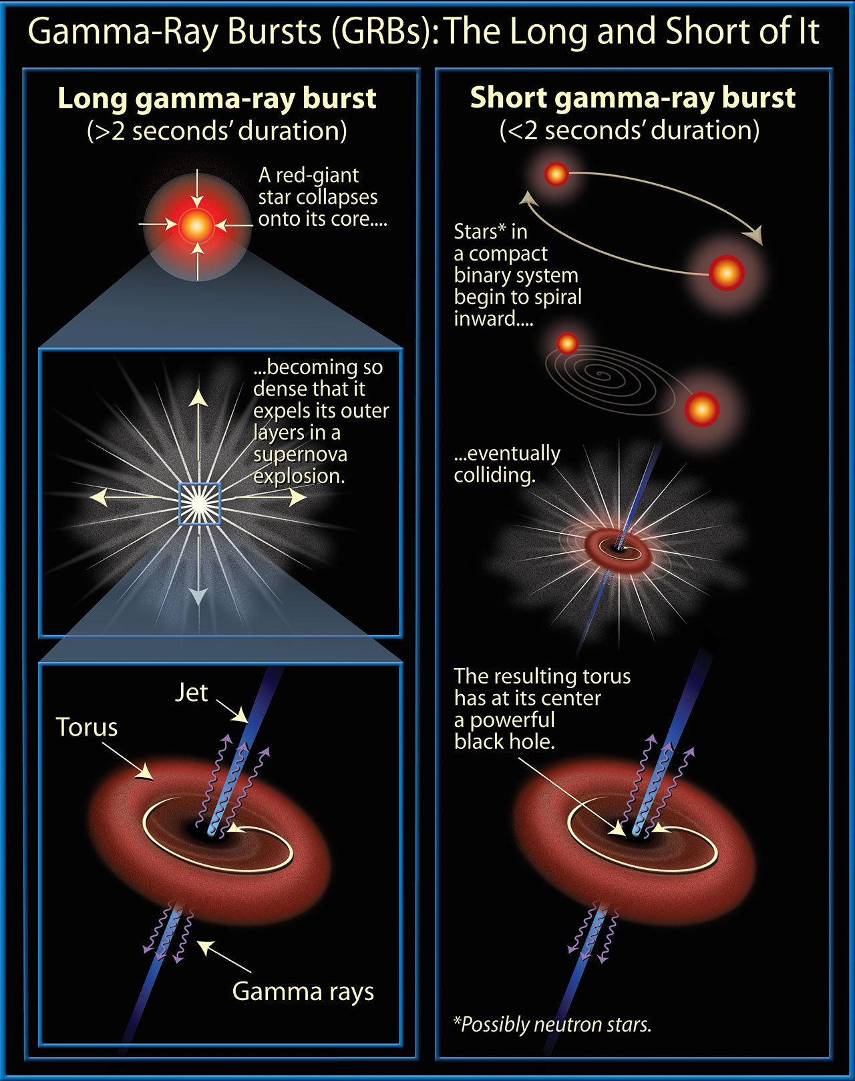
Notes:
Two distinct physical origins for cosmological GRBs
Long-duration GRBs: associated with deaths of certain massive stars
Linked to Type Ic supernovae: specific type of supernova lacking hydrogen, helium, and strong silicon lines
Massive stars lose outer layers before exploding, possibly through stellar winds or binary interactions
Short-duration GRBs: not associated with supernovae or massive stars
Found in regions of host galaxies with low star formation
Likely connected to compact objects such as neutron stars and black holes
Leading scenario: mergers of two neutron stars (NS-NS) or one neutron star and one stellar-size black hole (NS-BH)
Catastrophic event creates hyper-accreting stellar-size black hole or rapidly rotating, highly magnetized neutron star (millisecond magnetar)
These objects serve as engines for collimated jets
GRB event detected when jet is directed towards Earth
We analyze the GRB in the temporal (LC) and spectral domain.
A GRB source can be observed in the temporal domain in minutes, hours, days, weeks and even years after the burst itself.
In the spectral domain, GRBs have been detected in radio, mm, IR, optical, UV, X-rays and gamma-rays up to 100 GeV.
Different from other astronomical objects which could be detected in any wavelength at any time, GRBs must be observed as soon as possible due to the rapid fading of the afterglow.
Besides being strong emitters across the EM-spectrum, GRBs are also sources of non-EM radiation; such as ultra-high-energy cosmic rays (subatomic particles, million times greater than LHC), neutrinos and gravitational waves (ripples in spacetime caused by the acceleration of massive objects).
Direct observation of GW 170817 associated with GRB 170817A, which is believed to be the merger of two neutron stars. Exciting that the LIGO-VIRGO observatory will commence operation again this month.

Slide 6
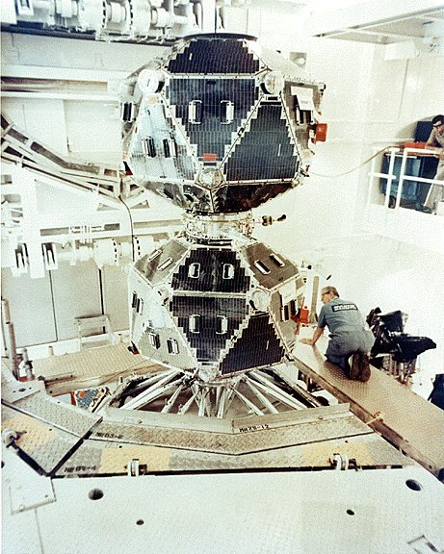
History of Gamma-Ray Burst Detection
Vela satellites (1963): Unintentional discovery of GRBs while monitoring nuclear bomb tests
CGRO/BATSE (1991): Revealed isotropic distribution of GRBs, suggesting extragalactic origins
BeppoSAX (1996): First to identify X-ray afterglows, enabling GRB localization and host galaxy discovery
Swift satellite (2004): Rapid detection and follow-up of GRBs, advancing our understanding of these events
Ongoing research: Detecting one GRB every day, exploring the universe's most energetic and distant phenomena
More science to be explored
Notes:
Vela satellites (1963): The first GRBs were discovered by the Vela satellites, which were designed to detect gamma rays from potential nuclear bomb tests after the Partial Test Ban Treaty was signed.
CGRO/BATSE (1991): BATSE onboard the CGRO revealed the isotropic distribution of GRBs, which hinted at their extragalactic nature.
BeppoSAX (1996): The BeppoSAX satellite was the first to identify an X-ray afterglow associated with a GRB, leading to the localization of GRBs and the discovery of their host galaxies.
Swift satellite (2004): Launched in 2004, Swift was specifically designed for the rapid detection and follow-up of GRBs, greatly contributing to our understanding of these events.
Current detection rate: Today, we detect approximately one GRB every day, providing valuable insights into some of the most energetic and distant phenomena in the universe.

Slide 7
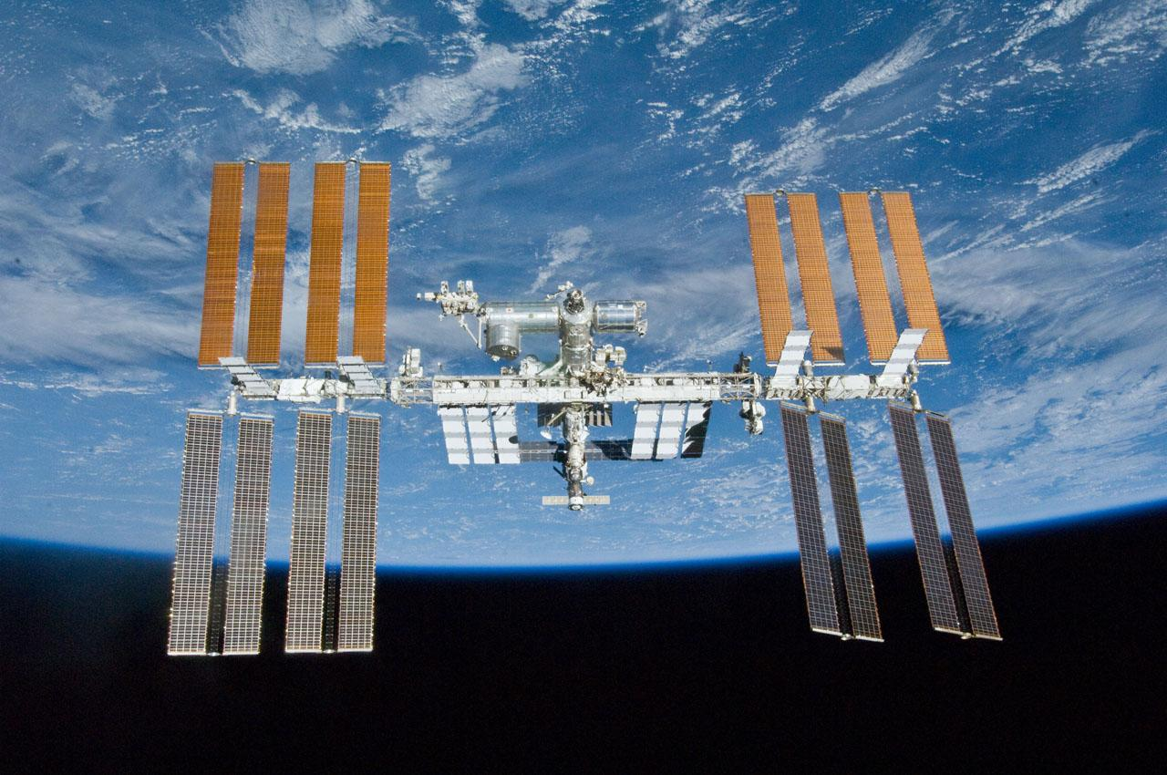
Notes:
ISS

Slide 8

Motivation
Notes:
ASIM is hosted on board ISS
First systematic exploration of cosmological gamma-rays.
Secondary science target for ASIM

Slide 9
ASIM and Other Instruments: Detecting and Studying Gamma-Ray Bursts
ASIM instrument: Studies TLEs and TGFs in Earth's atmosphere
Components: MXGS (X-rays and gamma rays) and MMIA (lightning and TLE detection)
TGFs are very localized events → GRBs
Konus-WIND: Gamma-ray burst detector since 1994
Fermi Gamma-ray Space Telescope: Detects GRBs since 2008
ASIM's unique location: International Space Station (ISS) for high precision and accuracy
ASIM detections: GRBs and magnetar flare (GRB 200415A)
Rapid detection: Captures events missed by other instruments
Valuable insights: Improves understanding of GRBs and the universe
Notes:
1. The ASIM instrument is a suite of detectors designed to study transient luminous events (TLEs) and Terrestial Gamma-rays (TGFs) in the Earth's atmosphere.
2. ASIM consists of two main components: the Modular X-ray and Gamma-ray Sensor (MXGS) and the Modular Multispectral Imaging Assembly (MMIA). The MXGS is designed to detect X-rays and gamma rays, while the MMIA includes two cameras and three high-speed photometers used for lightning and TLE detection.
3. The Konus-WIND instrument is a gamma-ray burst detector that has been in operation since 1994 and has detected thousands of GRBs.
4. The Fermi Gamma-ray Space Telescope is another instrument used to study GRBs, which has detected hundreds of these events since its launch in 2008.
5. ASIM is unique among GRB detectors in that it is located on the International Space Station (ISS), which provides a stable platform for observing TLEs and GRBs without atmospheric interference. This allows ASIM to detect and study TLEs and GRBs with high precision and accuracy.
6. ASIM has detected several GRBs since its launch in 2018, including GRB 200415A, which was a magnetar flare. Due to the rapid detection capabilities of ASIM, it was able to capture this event, while other instruments such as Fermi and Konus-WIND were saturated. These detections have provided valuable insights into the physics of these events and have helped to improve our understanding of the universe.

Slide 10
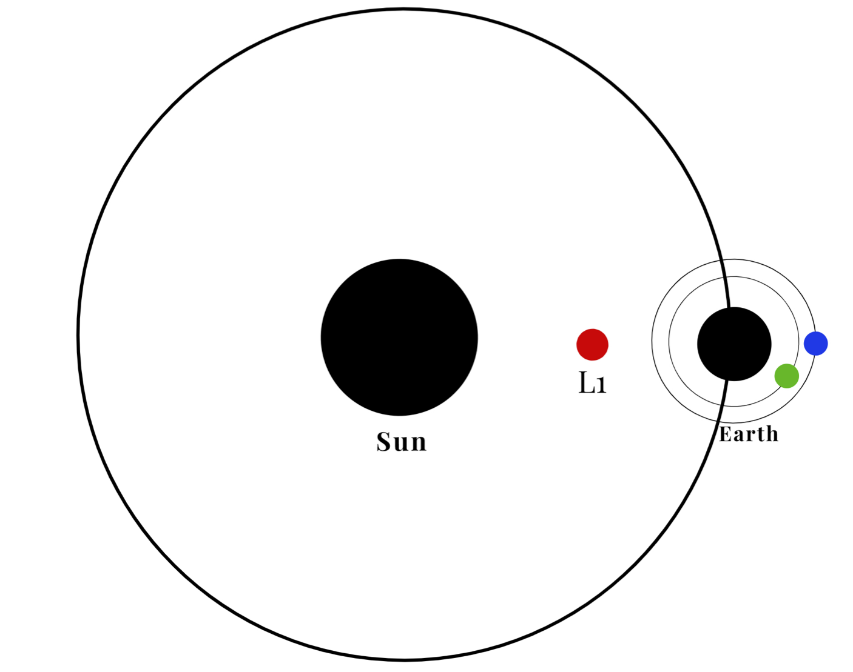
Notes:
Location of the instruments

Slide 11
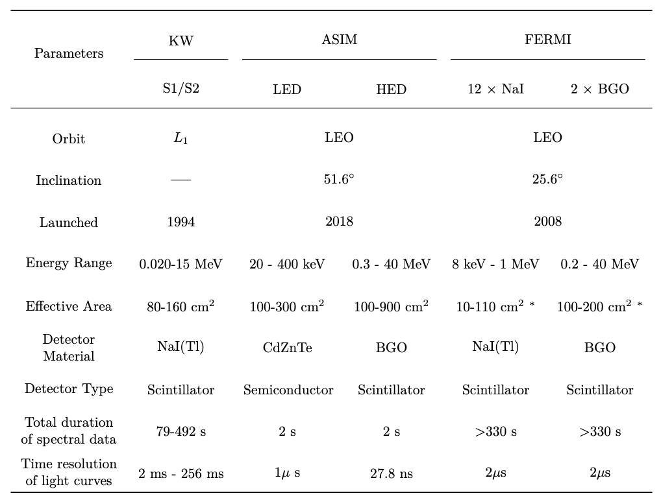
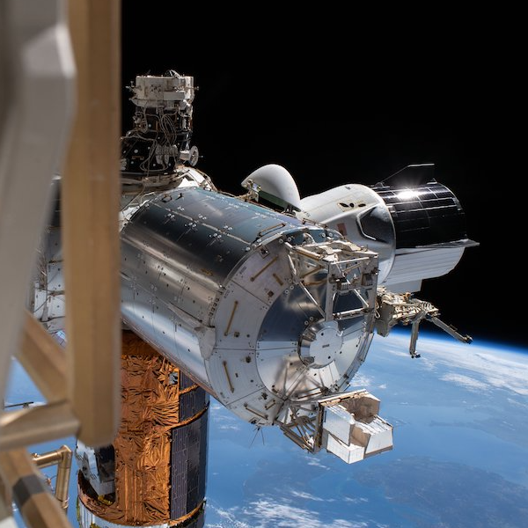
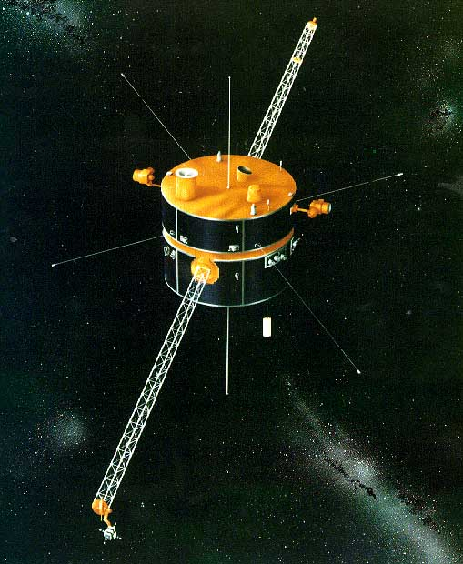
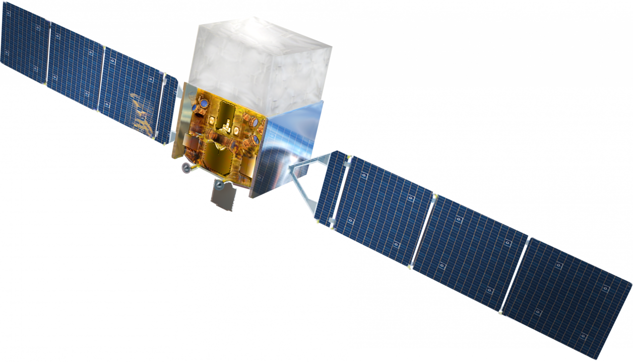
Spacecrafts & Instrumentation
ASIM
KW
Fermi
Notes:
Lay out the key features of the instruments

Slide 12
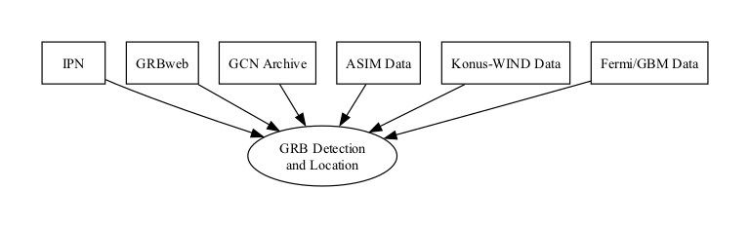
Data Sources and Detection Process for Gamma-Ray Bursts
IPN: Collaborative effort for GRB detection and location
GRBweb & GCN archive: Near real-time GRB information
ASIM data: Local database & custom software
Konus-WIND data: Provided by research colleagues
Fermi/GBM data: Sourced from Fermi/GBM burst database

Slide 13
Methodology for Joint Spectral Analysis of GRBs
Comprehensive workflow for joint spectral analysis
GRB identification: ASIM trigger list, IPN, and GRBweb collaboration
ASIM data preparation: extract data, import into a Python env. for data processing
Energy calibration: time-dependent calibration coefficients, quadratic fit
Cross-correlation of light curves: align reference frame, account for different trigger logics and reference times
Cross-correlation process: stingray software package, estimate time lags for highest correlation
Notes:
The methodology focuses on a comprehensive workflow to identify GRBs, prepare ASIM and Fermi data, cross-correlate light curves, perform spectral fitting, and ensure data consistency for joint spectral analysis.
GRB identification involves determining a correlation between the ASIM trigger list and GRBs identified by the InterPlanetary Network (IPN) or the GRBweb collaboration. A preliminary search yielded 31 matches, which were narrowed down to 12 confirmed GRBs suitable for spectral analysis after further examination.
ASIM data preparation entails extracting various metrics from the ASIM database, including the time of arrival of individual photons, BGO address, detector assembly unit address, detector address, energy channel, and type. The data is then imported into a Python environment for analysis, using libraries like Pandas and NumPy.
Energy calibration is crucial for accurate energy measurements, and it is achieved using time-dependent calibration coefficients for each BGO with a quadratic fit.
Cross-correlation of light curves is an essential step in aligning the light curves from different instruments in the correct reference frame. It measures the similarity between two signals as a function of time lag and is especially important due to different trigger logics and reference times of each instrument.
The cross-correlation process uses the software package stingray to create light curve objects for each instrument, and from the cross-correlation object, the time lags that would produce the highest correlation between the light curve objects are estimated.

Slide 14
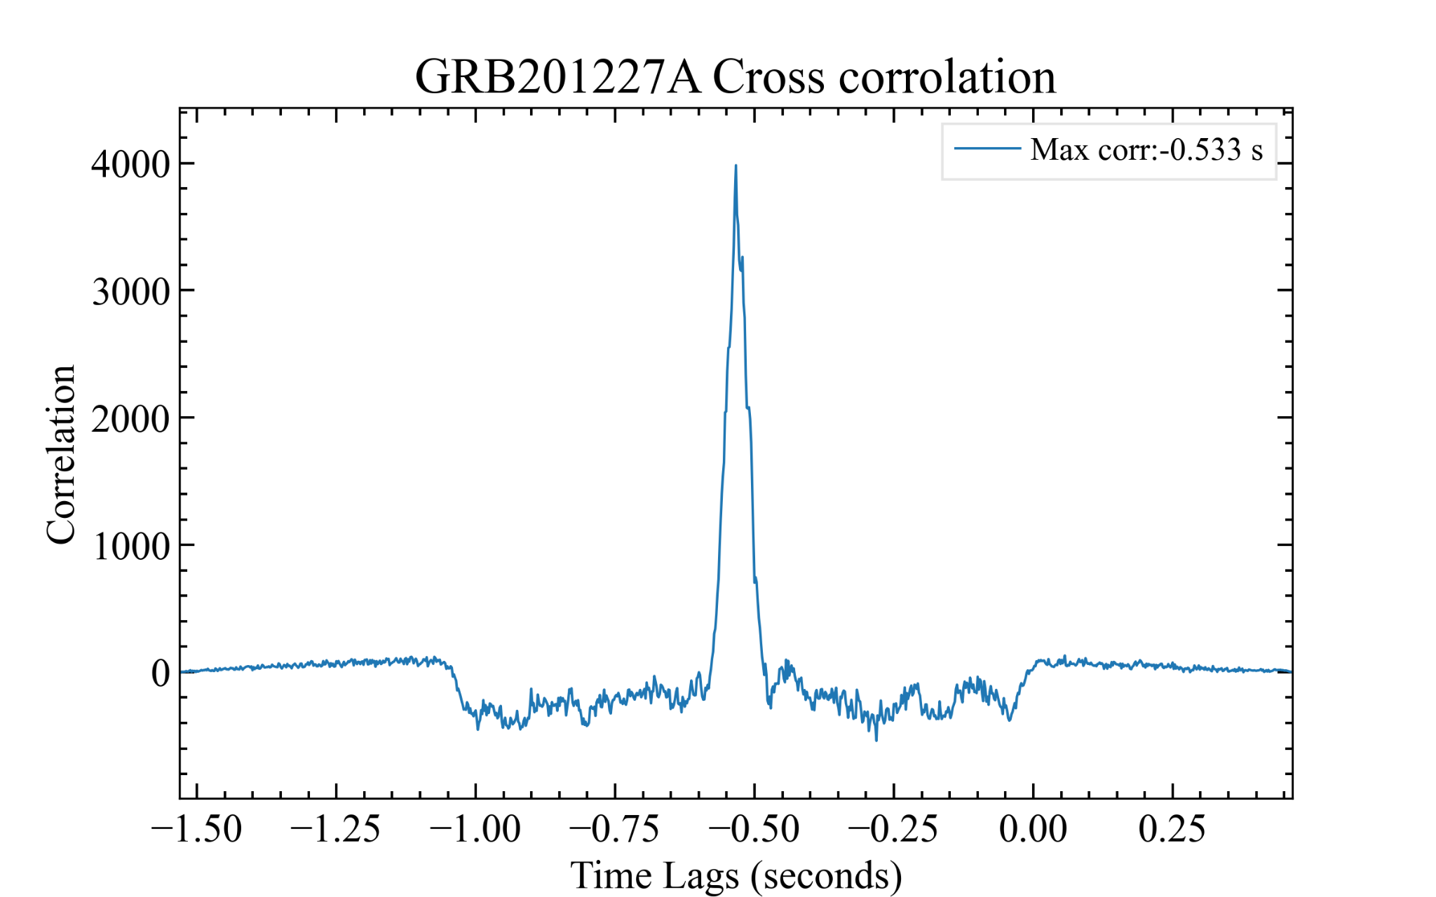
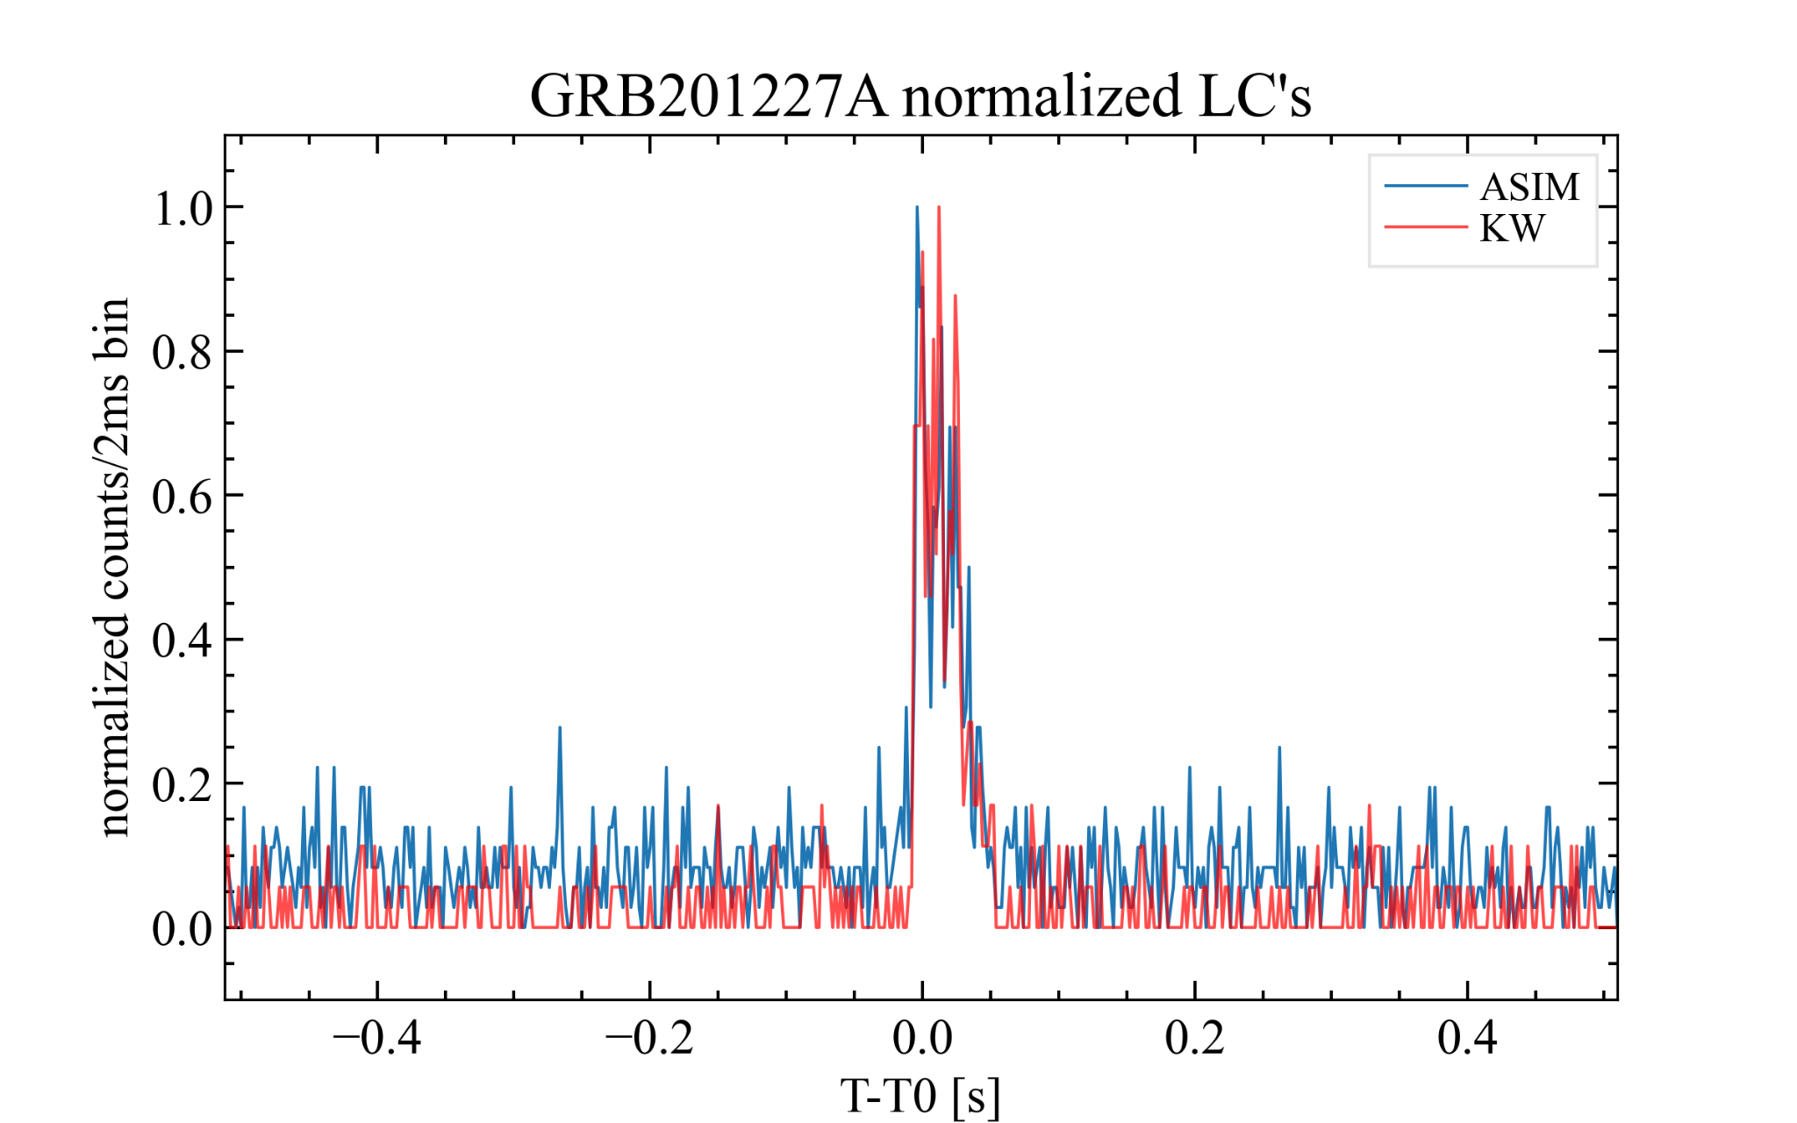
Cross Correlation: GRB 201227A
Align ASIM & FERMI T0: crucial to match Konus-WIND T0
ASIM & FERMI data usually brought into KW reference frame
KW data duration, usually 64 ms
HED energy range: 350-1500 keV (aligns with KW energy range)
Cross-correlation software: preferred over Time of Flight (ToF) method
HED/KW cross correlation
HED shifted into KW ref frame.
Both LC normalized to show correlation

Slide 15
Basics of Spectral Fitting
XSPEC: X-ray & gamma-ray data analysis
Spectra: derived from data & background files
Response Files: probability of detecting photons in energy channels
Models: locally modified cutoff power-law & Band function, parameterized with Ep
Constant normalization factor: accounts for systematic uncertainties in DRM
Fitting Procedure: forward folding method for best-fit parameters
Steps: load fits files, assign data groups, ignore bad channels, choose model, fix data group constant, fit command, determine confidence intervals
Confidence intervals: 90% confidence level for accuracy & reliability assessment
Notes:
XSPEC: spectral fitting software for X-ray and gamma-ray data analysis.
Spectra: observed spectrum derived from data (spectrum) and background files.
Response Files: response matrix describes the probability of detecting incoming photon with energy E in channel.
Models: locally modified cutoff power-law and Band function models used for spectral fitting, parameterized with Ep.
Constant normalization factor (cross-calibration coefficient) accounts for systematic uncertainties in the instrument's DRM and simulates how the instrument would detect the incident photon energies based on the chosen model.
Fitting Procedure: forward folding method with selected model spectrum to obtain best-fit parameters.
Steps in fitting procedure: load fits files, assign data groups, ignore bad channels, choose optimal model, fix data group constant, call fit command, and determine confidence intervals.
Confidence intervals: calculated based on 90% confidence level to provide accuracy and reliability assessment.

Slide 16
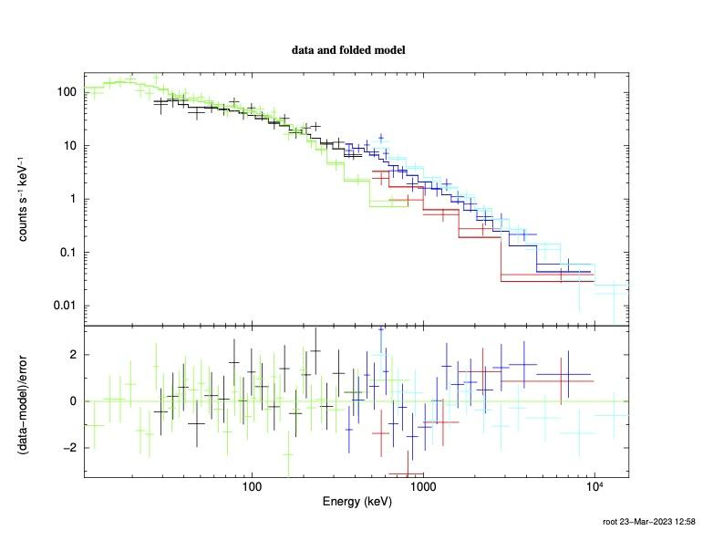
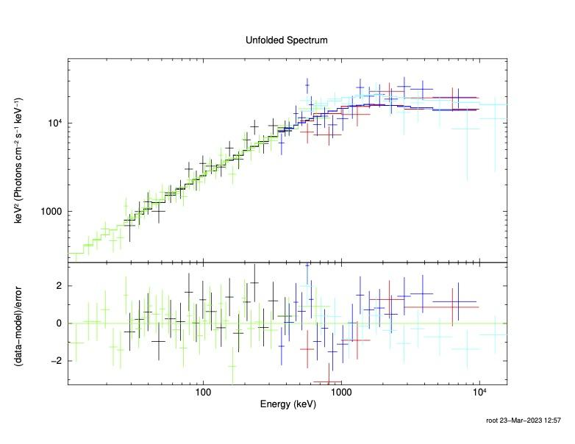
GRB 190606A

Slide 17
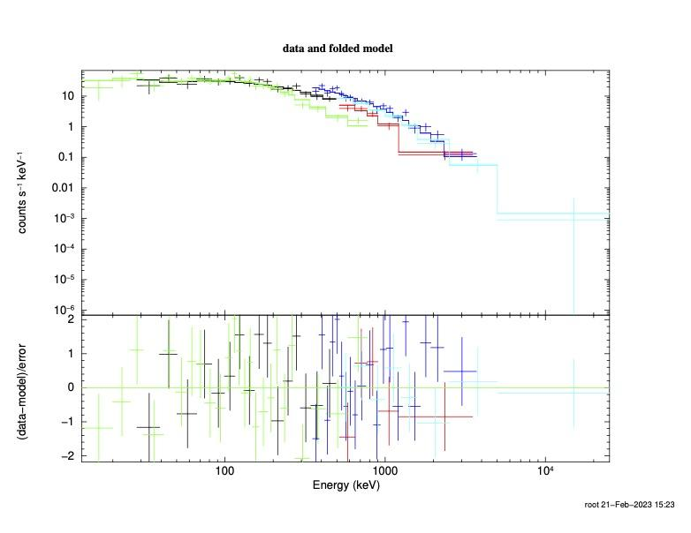
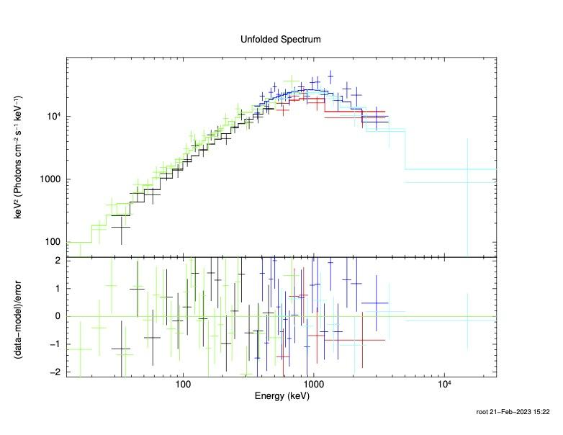
GRB 201227A

Slide 18
Results: ASIM's Performance in GRB Detection and Multi-Instrument Comparison
Analyzed 9 GRBs from ASIM (May 2018 - Dec 2021), 11 unique spectra ++
Focused on data processing pipeline & cross-calibration coefficients
Joint fit with Konus-WIND, Fermi/GBM ++
International collaboration in Case Study
ASIM: high sensitivity, rapid detection for GRBs
Measurements mostly consistent with other spacecrafts
ASIM detects shorter-duration bursts due to trigger logic
Importance of multi-instrument studies for understanding GRBs
ASIM's role in studying GRBs
Notes:
- In total, we analyzed data from 9 GRBs detected by ASIM between May 2018 and December 2021 and performed a joint spectral fit on 11 unique spectra.
- My analysis focused on the data processing pipeline and estimating the cross-calibration coefficients.
- I compared our results with those obtained from other spacecraft, such as Konus-WIND, Fermi/GBM and Swift/BAT, to assess ASIM's performance as a GRB detector. This comparison involved looking at how well ASIM's measurements agreed with those obtained from other instruments and identifying discrepancies.
-International collaboration with researchers from Spain and Italy on specific burst for my Case Study.
- Overall, our analysis demonstrates that ASIM is capable of detecting GRBs with high sensitivity and rapid detection times. This is an important finding because it highlights ASIM's potential as a valuable tool for studying these events.
- We also found that ASIM's measurements of GRB properties are generally consistent with those obtained from other spacecraft, although there are some discrepancies. For example, we found that ASIM tends to detect shorter-duration bursts because of it's trigger logic.
- These findings highlight the importance of multi-instrument studies in improving our understanding of GRBs and their underlying physics. By combining data from multiple instruments, we can obtain a more complete picture of these events.
- In summary, our analysis provides valuable insights into the capabilities of ASIM as a GRB detector and contributes to ongoing efforts to study these fascinating cosmic events.

Slide 19
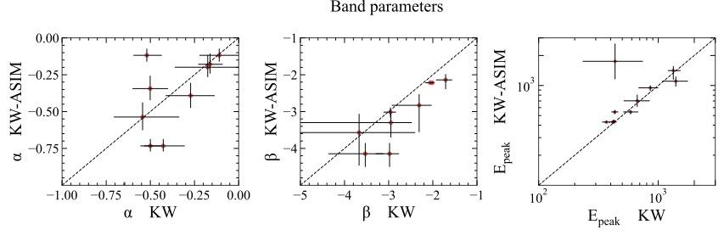
Comparison of Band Parameters: KW-ASIM vs. KW-only Spectral Analysis
Systematic trends in model parameters
Correlation between Band parameters for KW-ASIM and KW-only
Line of equality shown by dashed black line
Deviations observed, particularly for Epeak
Outlier example: GRB 190606A due to fitted energy bands
GRB 190606A's Epeak in GCN for KW spectrum: 664 (+1038, -388) keV
Notes:
Investigating systematic trends in model parameters from joint spectral analysis and KW fit alone
Scatter plots depict correlation between Band parameters α, β, and Epeak for KW-ASIM and KW-only spectral analysis
Horizontal and vertical lines represent error bars
Dashed black line indicates line of equality (where values from both models would be the same)
Some bursts best fitted by CPL model instead of Band model for KW data only
Generally, KW-ASIM values are consistent with KW-only values, but deviations observed, particularly for Epeak
Outliers present, notably for GRB 190606A, possibly due to differences in fitted energy bands
Higher Epeak for hard burst GRB 190606A, since joint fit was conducted up to 40 MeV
GRB 190606A's reported Epeak-value in GCN for KW spectrum: 664 (+1038, -388) keV

Slide 20
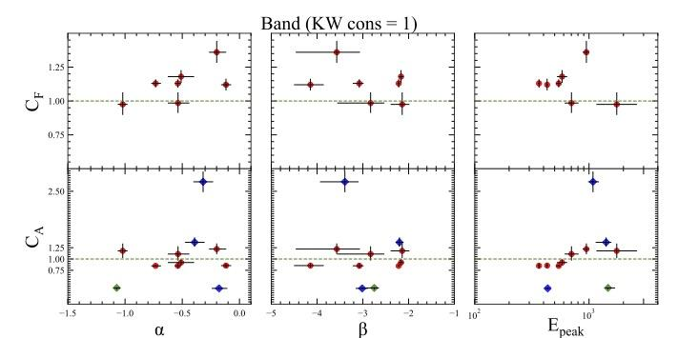
Cross-calibration coefficients from joint spectral analysis
Top subplots: Fermi calibration coefficient, Bottom subplots: ASIM coefficient
Red: KW-ASIM-Fermi analysis, Blue: KW-ASIM analysis, Green: ASIM-Fermi (GRB 211211A)
Green dashed line: expected coefficient of 1
Outliers: GRB 190206A, 190305A, 211211A
Notes:
Stacked scatter plot illustrating cross-calibration coefficients from joint spectral analysis.
Top three subplots: cross-calibration coefficient C_F vs. alpha, beta, and Epeak for KW-ASIM-Fermi analysis.
Bottom three subplots: cross-calibration coefficient for ASIM C_A.
Red dots: KW-ASIM-Fermi joint spectral analysis.
Blue dots: KW-ASIM joint spectral analysis.
Green dots: ASIM-Fermi joint spectral analysis for GRB 211211A.
Green dashed line: expected cross-calibration coefficient of 1.
Outliers: GRB 190206A, 190305A, and 211211A.

Slide 21
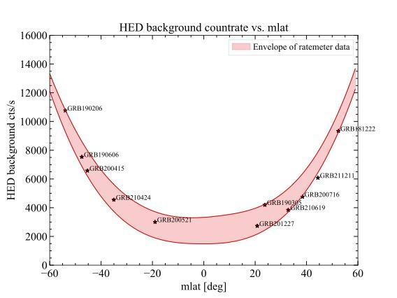
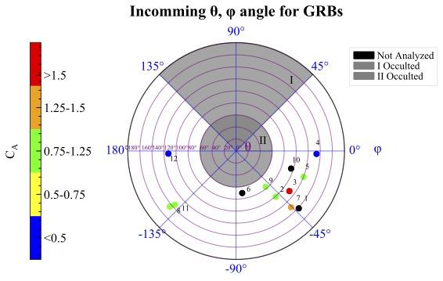
ASIM Data Analysis Pipeline Consistency Check
Light Curve Analysis: Correct spectrum extraction
Background Ratemeter Analysis: Reliable background spectra
DRM Analysis: Aligned reference frames & absorption accounting
Energy Calibration Coefficients: Ruled out as error source
Mass Model Consistency: Identifying & addressing inconsistencies
ASIM FITS Analysis: Validated software accuracy
Notes:
Light Curve Analysis: Confirmed the correct spectrum was extracted at the appropriate time interval for GRBs with large deviations in cross-calibration coefficients
Background Ratemeter Analysis: Verified the reliability of accumulated background spectra and ruled out incorrect background as the cause for anomalous cross-calibration coefficients
DRM Analysis: Ensured alignment of reference frames for DRMs and GRBs and confirmed DRMs account for absorption caused by the Columbus module
Energy Calibration Coefficients Analysis: Investigated the possibility of errors due to energy calibration coefficients but concluded they are not the source of error
Consistency of the Mass Model: Identified some inconsistencies in the mass model and ongoing efforts to improve response matrices
ASIM FITS Analysis: Validated the accuracy of the ASIM FITS software by cross-checking accumulated spectrum with existing data

Slide 22
Introduction to Case Studies
Peculiar Bursts: GRB 210619B & GRB 211211A
Unraveling GRB Physics and Mechanisms

Slide 23
GRB 210619B: Key Features & Observations
Originates from a faint dwarf galaxy with a redshift of z=1.937 ~10 Billion yr
Highly luminous burst, ranking among the top 10 observed by Fermi
Spectral Evolution: Transition from thermal outflow to non-thermal outflow observed in time-resolved spectral analysis

Slide 24
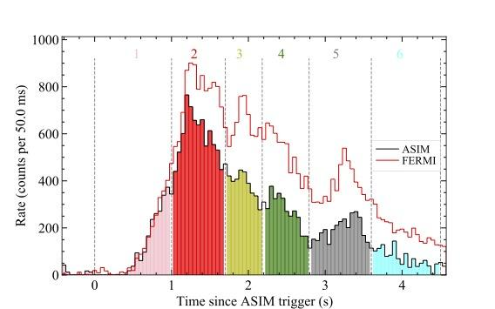
GRB 210619B: Time-Resolved Spectroscopy
Multi-Wavelength Observations Crucial
Harder Alpha: Thermal Emission (Photospheric Regions)
Softer Alpha: Non-Thermal Synchrotron Emission
Transition Linked to Jet Composition Change
Notes:
Time resolved spectroscopy used to understand the jet composition in the prompt emission.
For GRB 210619B, we see the evolution from thermal (matter dominated) to non-thermal (Poynting flux). This is supported by the transition from hard (passing the LOD -3/2 for synchrotron) to soft alpha.
Harder alpha values during brighter emission pulses due to thermal emission from photospheric regions
Softer alpha values during longer/softer emission phase consistent with non-thermal thin shell synchrotron emission
Transition suggests a change in jet composition, possibly from a matter-dominated hot fireball to a Poynting flux-dominated outflow

Slide 25
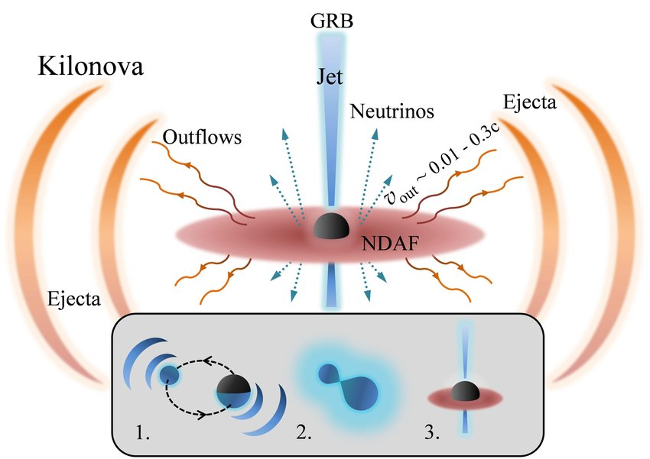
GRB 211211A: Key Features & Observations
Hybrid Burst: Long & Short Traits
Possible Origins: Compact Object Mergers (NS-BH or NS-NS)
Gravitational Waves
Tidal Forces & Magnetar Energy Release: Super Flare Precursor
Notes:
Hybrid burst exhibiting characteristics of both long and short gamma-ray bursts
Possible origins: Merger of a neutron star (NS) and a black hole (BH) or a pair of NSs, with one being a highly magnetized magnetar
Tidal forces tearing apart the magnetized magnetar during the binary system's inspiral phase leading to a powerful super flare precursor

Slide 26
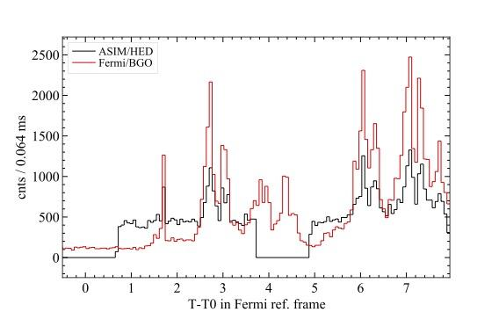
GRB 211211A: Time-Resolved Spectroscopy
Energetic Intervals: 1 & 3
LIGO/VIRGO not operational
Consistent Hybrid Scenario
Upcoming paper with research colleagues
Notes:
Reveals most energetic intervals: 1 and 3, with $E_{peak}$ $\sim$ 1467 keV and 1563 keV, respectively
Consistent with a hybrid scenario throughout the emission, although further confirmation needed
Detailed examination of GRB 211211A enhances our understanding of such enigmatic astronomical events

Slide 27
Summary
Systematic exploration of cosmic GRBs detected by ASIM
Identified 12 verified bursts (2018-2021)
Case studies: GRB 210619B and GRB 211211A
Developed architecture for extracting ASIM spectra
Joint spectral analysis (ASIM, KW, Fermi)
Expansion of ASIM's scientific impact
Notes:
Systematic exploration of cosmic GRBs detected by ASIM
Identified 12 verified bursts between June 1st, 2018, and December 31st, 2021
Case studies: GRB 210619B and GRB 211211A
Developed architecture for extracting ASIM spectra and streamlined data preparation
Joint spectral analysis of ASIM, KW, and Fermi spectra for a subset of bursts
Expansion of ASIM's scientific impact

Slide 28
Future Work
Enhance response matrices
Expand analysis (GRB duration, distribution)
Hypothesis: ASIM detects short, bright, energetic GRBs
Leverage ASIM's timing capabilities
Notes:
Enhance response matrices by examining the mass model and cross-checking with the full CAD model of ASIM
Expand analysis to include GRB duration (T90, T50) and distribution in relation to the GRB catalog
Hypothesis: ASIM detects fewer GRBs, but they are short, bright, and energetic, making them highly interesting for follow-up analysis
Leverage ASIM's timing capabilities for a follow-up study on GRB timing properties

Slide 29
Upcoming Opportunities
New LIGO-VIRGO GW observing run (May 2023)
Future GRB analysis with ASIM expertise
TOTEM follow-up mission
Establish GRB data analysis pipeline for TOTEM
Notes:
New LIGO-VIRGO gravitational waves observing run commencing in May 2023
Future GRB analysis using ASIM expertise and code
TOTEM follow-up mission: A smaller version of MXGS with improved features
Establish a GRB data analysis pipeline for TOTEM

Slide 30


